Slide 1
An ERD
A representation of
a simple clinic’s data model

Slide 2



Symbols Used
Entity
Relationship
Cardinality
Odinality

Slide 3

Two entities with a relationship

Slide 4
RELATIONSHIP
A DOCTOR treats A PATIENT

Slide 5
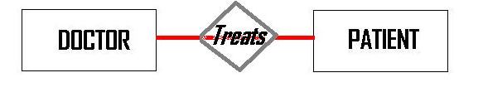
RELATIONSHIP
A DOCTOR treats A PATIENT

Slide 6
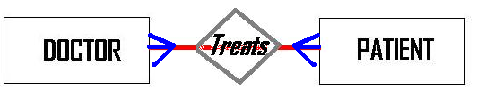
Relationship Type; Cardinality
A DOCTOR treats A PATIENT
A DOCTOR treats MANY PATIENTS

Slide 7
Relationship Type; Cardinality
A PATIENT is treated by A DOCTOR
A PATIENT is treated by MANY DOCTORS

Slide 8
Relationship Type; Cardinality
A DOCTOR treats A PATIENT
A DOCTOR treats MANY PATIENTS
MANY DOCTORS treat A PATIENT
MANY DOCTORS treat MANY PATIENTS

Slide 9
ORDINALITY

Slide 10
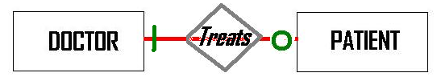
ORDINALITY
A DOCTOR may treat A PATIENT
A DOCTOR may not treat A PATIENT

Slide 11
ORDINALITY
A PATIENT must be treated by A DOCTOR

Slide 12
ORDINALITY
A DOCTOR may treat A PATIENT
A DOCTOR may not treat A PATIENT
A PATIENT must be treated by A DOCTOR

Slide 13

A DOCTOR may treat A PATIENT
A DOCTOR may not treat A PATIENT
A PATIENT must be treated by A DOCTOR
A DOCTOR treats A PATIENT
A DOCTOR treats MANY PATIENTS
MANY DOCTORS treat A PATIENT
MANY DOCTORS treat MANY PATIENTS

Slide 14
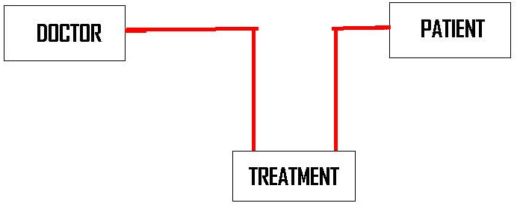
A DOCTOR gives A TREATMENT
A TREATMENT is given to A PATIENT
A PATIENT receives A TREATMENT
A TREATMENT is received by A PATIENT

Slide 15
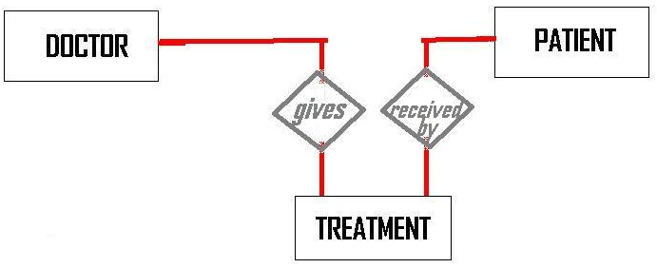
A DOCTOR gives A TREATMENT
A TREATMENT is given to A PATIENT
A PATIENT receives A TREATMENT
A TREATMENT is received by A PATIENT

Slide 16
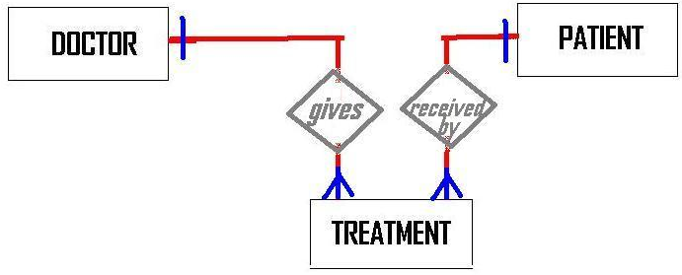
A DOCTOR gives A TREATMENT
A DOCTOR gives MANY TREATMENTS
A TREATMENT is given by A DOCTOR
MANY TREATMENTS are given by A DOCTOR
A PATIENT receives A TREATMENT
A PATIENT receives MANY TREATMENTS
A TREATMENT is received by A PATIENT
MANY TREATMENTS are received by A PATIENT

Slide 17
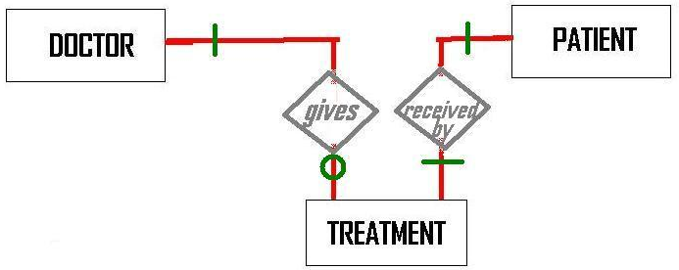
A DOCTOR may give A TREATMENT
A DOCTOR may not give A TREATMENT
A TREATMENT must be given by A DOCTOR
A PATIENT must receive A TREATMENT
A TREATMENT must be received by A PATIENT

Slide 18
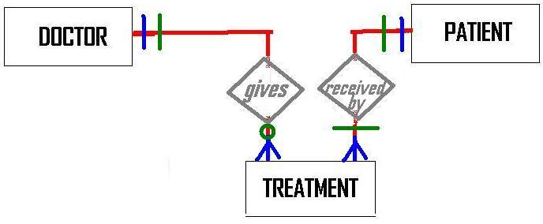
A DOCTOR may give A TREATMENT
A DOCTOR may not give A TREATMENT
A TREATMENT must be given by A DOCTOR
A PATIENT must receive A TREATMENT
A TREATMENT must be received by A PATIENT
A DOCTOR gives A TREATMENT
A DOCTOR gives MANY TREATMENTS
A TREATMENT is given by A DOCTOR
MANY TREATMENTS are given by A DOCTOR
A PATIENT receives A TREATMENT
A PATIENT receives MANY TREATMENTS
A TREATMENT is received by A PATIENT
MANY TREATMENTS are received by A PATIENT

